Slide 1
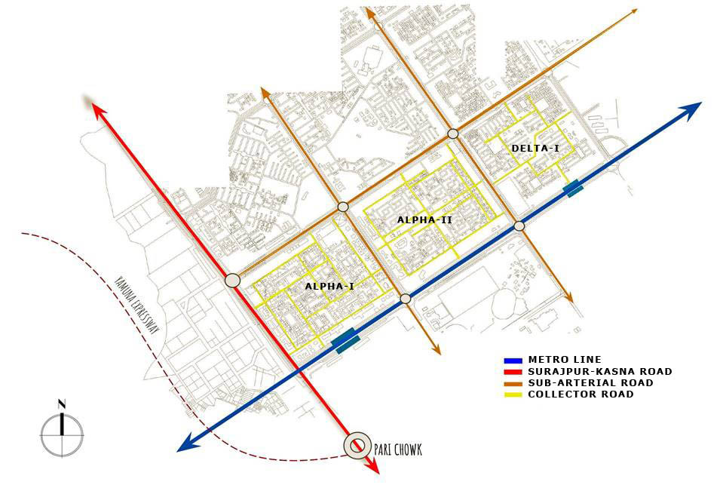
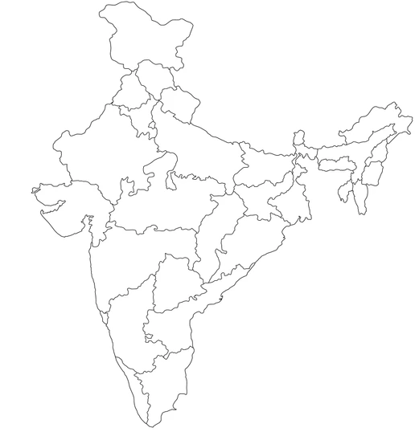
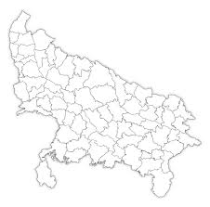
MAP OF INDIA
UTTAR PRADESH
YAMUNA EXPRESSWAY
MAP OF STUDY AREA, GREATER NOIDA

